Slide 1
Summarize lesson2: Discovering yourself
Module 1

Slide 2
Group Members
Loem sophiem
Keo Tangem
Chhoeuth sell
Hout Lyhour
Hang vansao

Slide 3
Agenda
Learning and memorizing
Learning process
Passive and active learning
Learning style

Slide 4
Learning Vs Memorizing
Learning
Meaning
Memorizing
Learning occurs when
Memorizing occurs when
Understand a subject
Make the since of a subject in to your own worlds.
Do it with your knowledge and apply it
Connect your news that you have with your lesson.
Remembering a fact
Listening to or repeating information to remembering
Information that you need to recall (password ,names ,addresses , etc )

Slide 5
Learning Process
is a process that students through and acquire new knowledge and skills and ultimately influence their attitudes, decision and actions.
Remember: Note and member it the first…
Understands: Explant summarize…
Analyze: compare, organize, examine…
Use: apply…
Evaluate: decide, find advantage and disadvantage…
Create: give suggest, correct, add idea…
Bloom’s learning Domains:

Slide 6
Passive and Active learning
What is passive learning ?
What is Active learning?
The learning processes of Evaluate and Create are the most active.

Slide 7
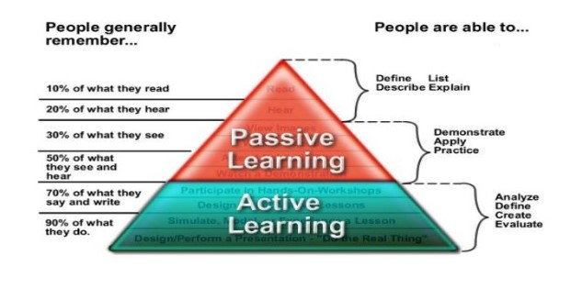
Passive and active
Note talking
Note taking
Reading
Class project

Slide 8
Learning style
Definition : is your own way of learning new information and ideas.
Learning style has three types:
Auditory learners
Visual learners
Kinesthetic/tactile learners

Slide 9





Thank you !
www.passerellesnumeriques.org

